Slide 1
Ninh Hiep Primary School
ENGLISH 3
Teacher: Nguyen Van Long
Tel: 0976 179 336

Slide 2
P
l
e
a
s
e
h
e
l
p
t
h
e
m
o
n
k
e
y
h
a
n
g
t
h
e
s
i
g
n
s
u
n
d
e
r
t
h
e
r
i
g
h
t
b
o
x
e
s
f
r
o
m
1
t
o
1
0

Slide 4
Take the redundant letter out from each word to make it correct.
PURGPLE à _______________________________
CRAYEON à _______________________________
WHQAT à _________________________________
MEEWT à _________________________________
LISOTEN à ________________________________
PIENCIL à _________________________________
BEOY à _________________________________
TEADCHER à ______________________________
NBICE à _________________________________
PEZN à _________________________________

Slide 8
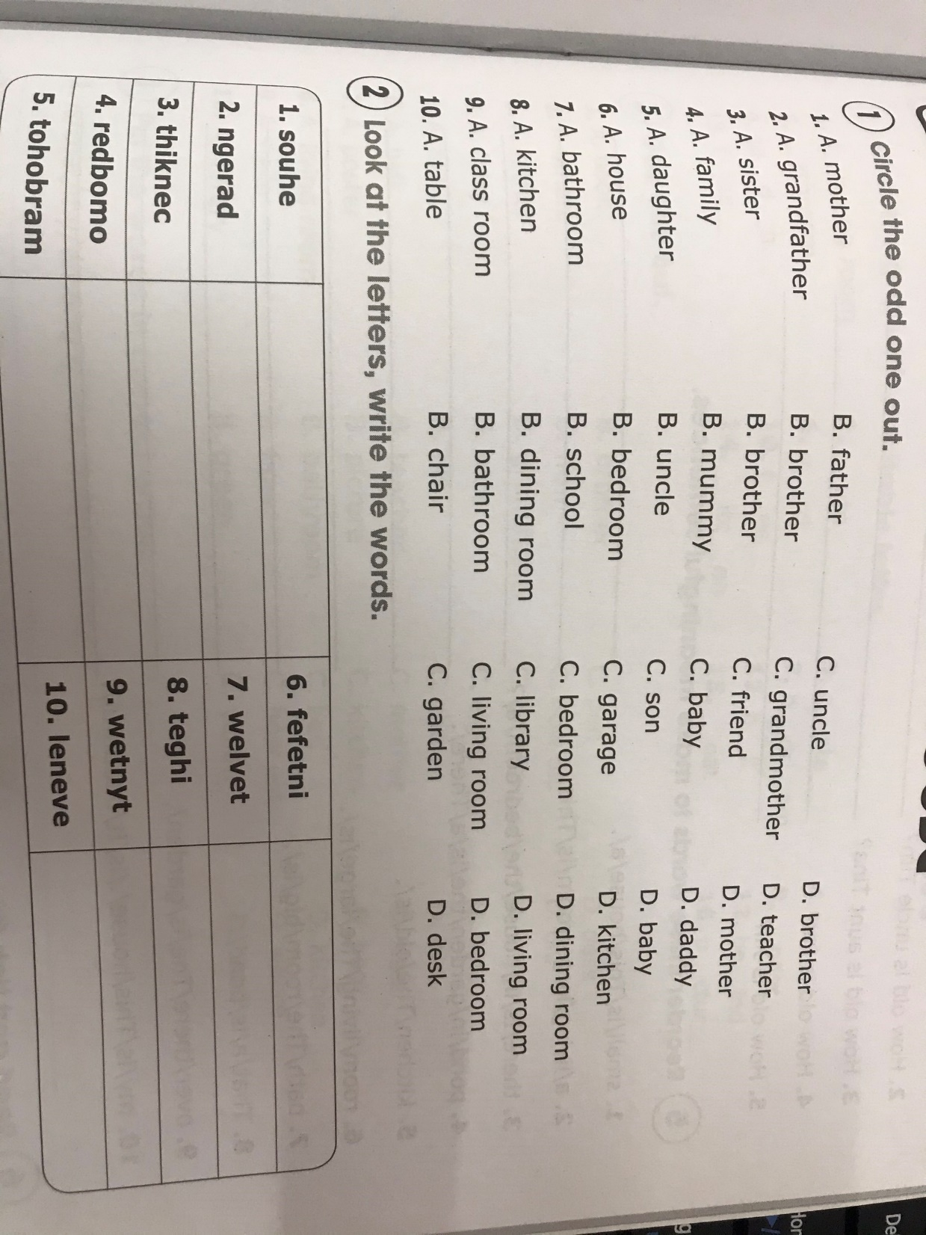

Slide 9
